Slide 1
Reproducible Manuscripts
Chris Baldassano
PSYC GR6130, Fall 2019

Slide 2
A simple Reproducible Pipeline
Analysis 1
Plot 1
Final report
Analysis 2
Plot 2
Data
Report text
Markdown file

Slide 3
A Complex Reproducible Pipeline
FSL
Plot in R
Final paper
Slow Python Analysis
Plot in Python
Data
Manuscript text

Slide 4
Writing a Paper Recipe
A complex paper may require multiple analyses in multiple pieces of software, some of which may be slow to run
Goal: write a “recipe” stating how to create our final paper
Then whenever we change some part of the analysis/text, we can use this recipe to determine:
which parts of the pipeline need to be re-generated
which order they should be re-generated in
which commands should be run to re-generate these parts

Slide 5
paper
https://danmun.ro/2019/05/23/make-for-research.html

Slide 6
GNU Make
Standard tool for compiling codebases since 1976
Most likely already installed on your computer
Uses plain text files (plays well with git)
Connects to IDEs like RStudio and PyCharm (with a plugin)
Only downside: made by nerds, for nerds, so syntax (especially advanced syntax) can get unreadable

Slide 7
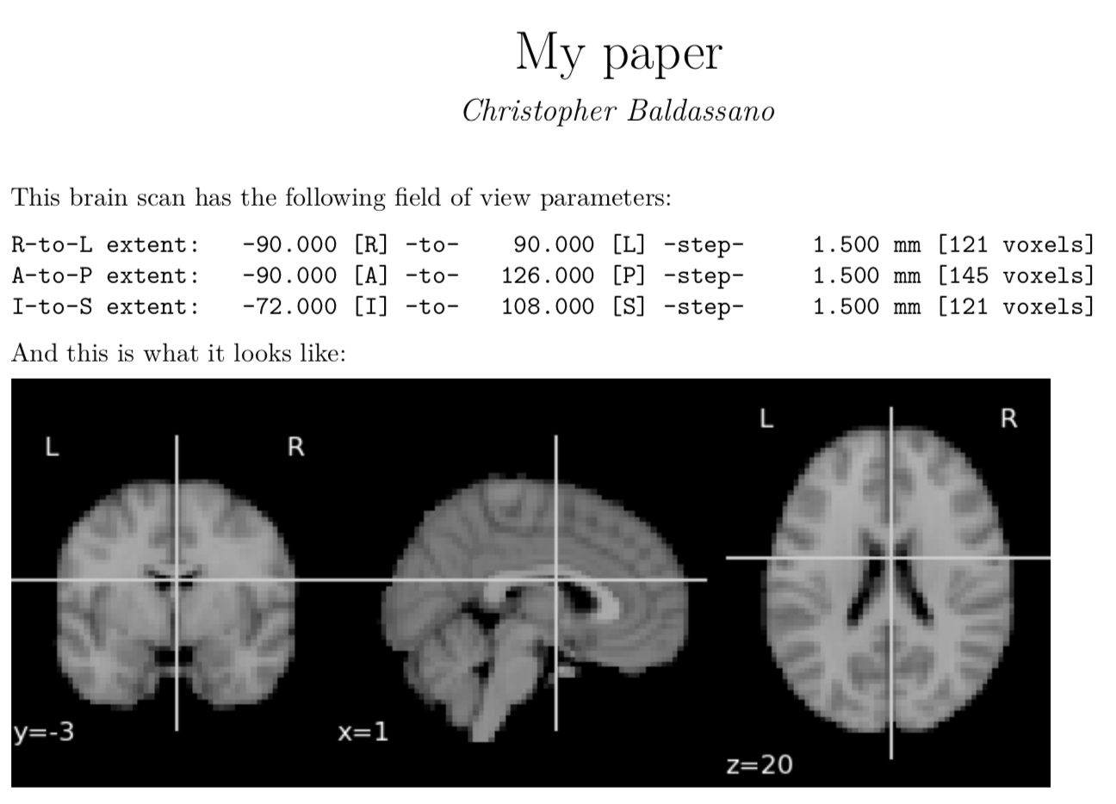
Example: paper.pdf

Slide 8
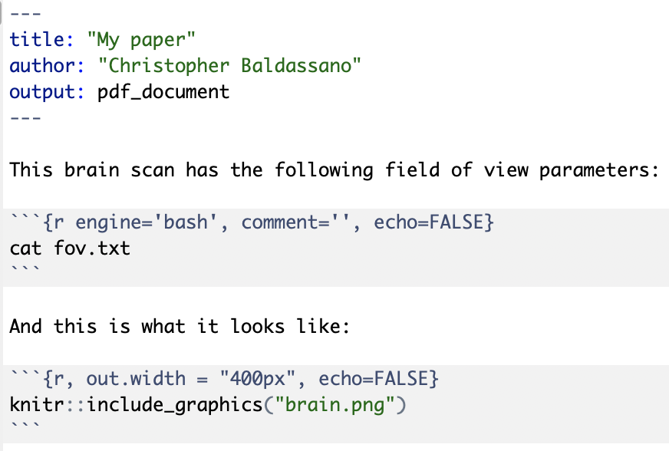
Example: Paper.RMD

Slide 9
Example: Generating FOV.TXT
3dinfo MNI152.nii | grep voxels > fov.txt

Slide 10

Example: plotbrain.py

Slide 11
Full Recipe
paper.Rmd
MNI152.nii
fov.txt
paper.pdf
3dinfo
rmarkdown
plotBrain.py
brain.png

Slide 12
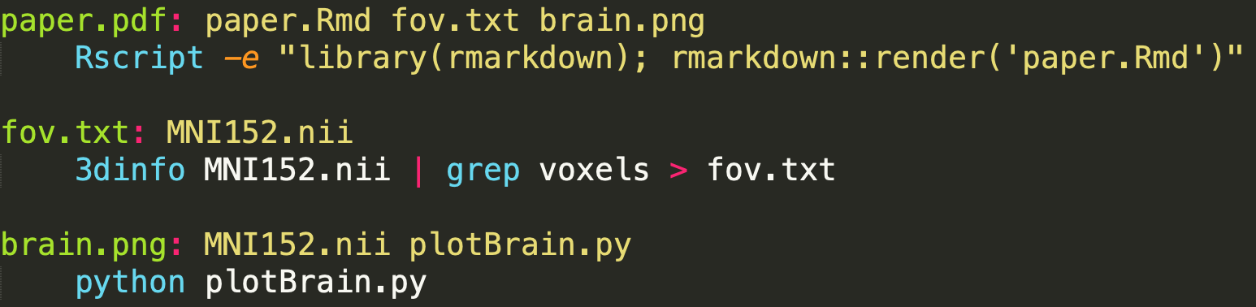
Makefile

Slide 13
Using make
From command line, call make [target]
Make then uses the makefile to figure out recursively:
Which dependencies of [target] don’t exist, or are “stale” (older than their own dependencies, indicating they need to be rebuild)
Which order to call the production commands in order to get every dependency up to date, and then rebuild the target
The “dry-run” option shows make’s plan but doesn’t actually execute it, for sanity-checking/debugging

Slide 14
Using Make
> make --dry-run paper.pdf
3dinfo MNI152.nii | grep voxels > fov.txt python plotBrain.py Rscript -e "library(rmarkdown); rmarkdown::render('paper.Rmd’)”
> make paper.pdf
[Lots of debug output from the tools, spits out paper.pdf]
> make paper.pdf
make: `paper.pdf' is up to date.

Slide 15
Using Make
> touch plotBrain.py
> make --dry-run paper.pdf
python plotBrain.py
Rscript -e "library(rmarkdown); rmarkdown::render('paper.Rmd')"

Slide 16
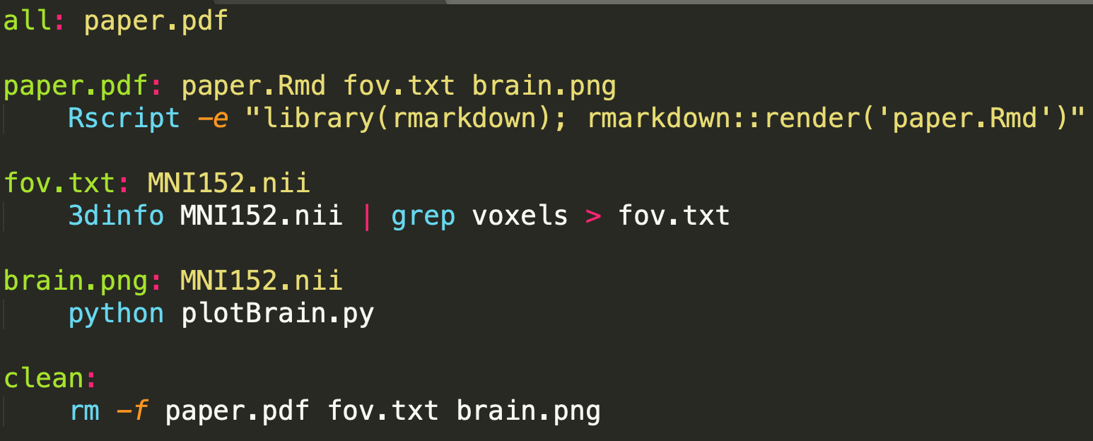
Makefile
Can create “virtual” targets
By default, make uses the all target

Slide 17
Debugging
> make clean
> make --dry-run --debug
Updating goal targets....
File `all' does not exist.
File `paper.pdf' does not exist.
File `fov.txt' does not exist.
Must remake target `fov.txt'.
3dinfo MNI152.nii | grep voxels > fov.txt
Successfully remade target file `fov.txt'.
File `brain.png' does not exist.
[…]

Slide 18
Parallel execution
Some targets (like fov.txt and brain.png) can be build simultaneously, since they don’t depend on one another
To allow make to run jobs in parallel:
> make --jobs=2

Slide 19
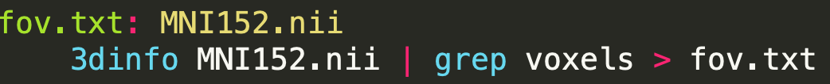
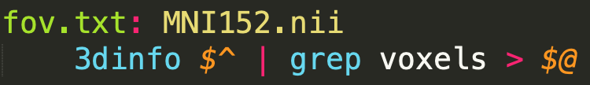
Fancy notation
Makefiles typically involve a lot of repetitive filenames, since they will usually appear both in the dependencies line and in the file command
Can use “automatic variable” shorthand:
$@ = target of rule
$^ = dependencies of rule

Slide 20
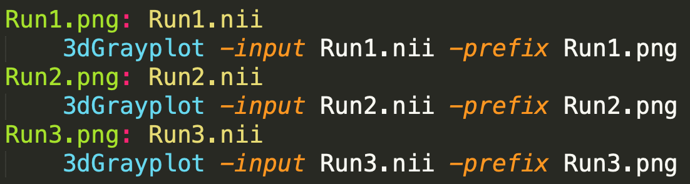
Pattern Rules
What if we have to make many repetitive figures with the same dependency and command structure?

Slide 21
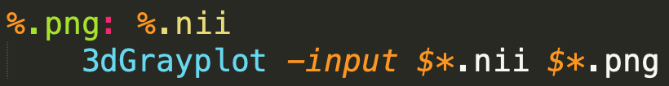
Pattern Rules
% is a wildcard that can match any filename
$* gives the filename that was matched for this command (without its suffix)

Slide 22
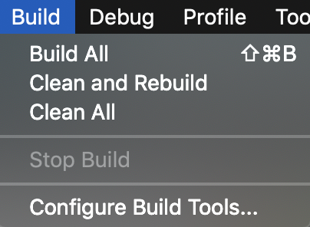
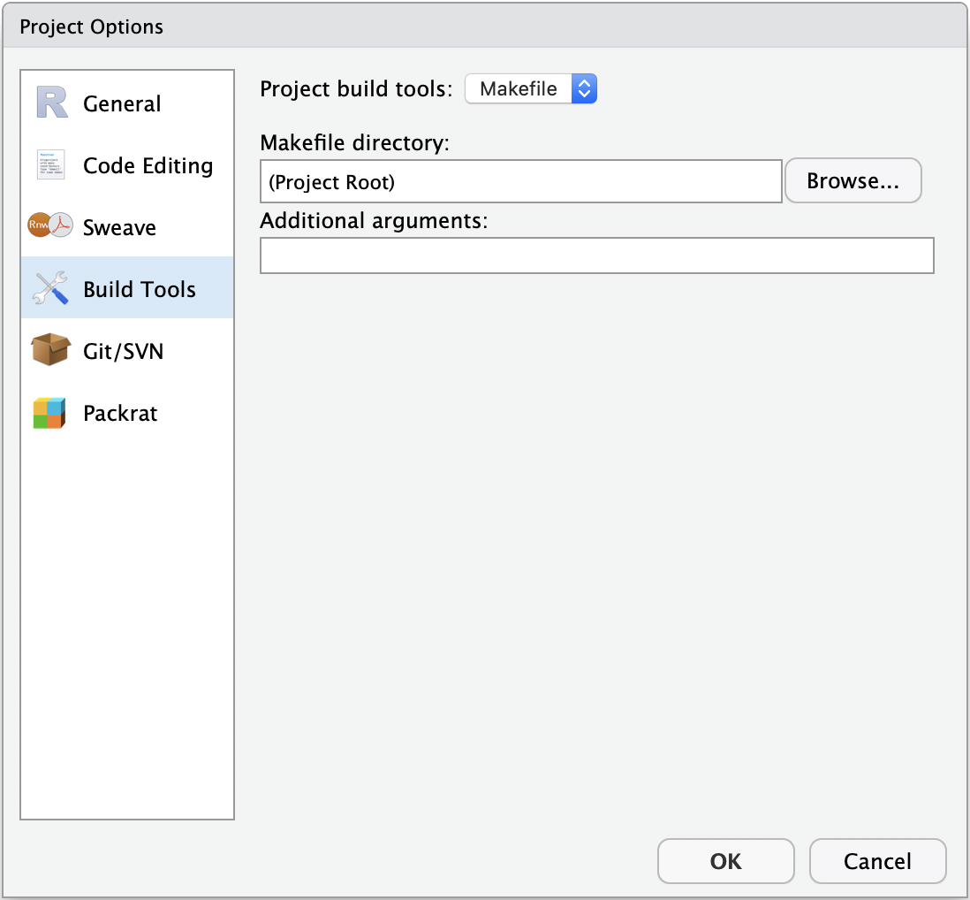
IDE InTegration

Slide 23
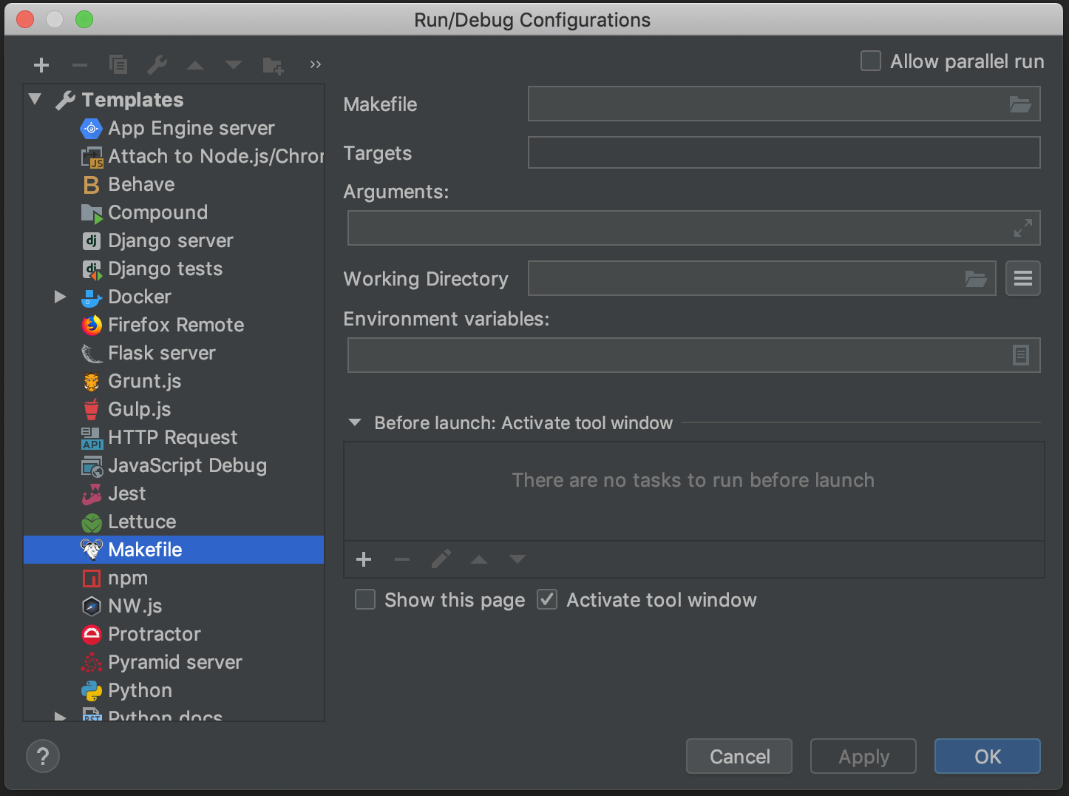
IDE InTegration

Slide 24
Lab
Assignment: https://classroom.github.com/a/N6HTFNHA
Git clone, and open NYC_report.docx

